Slide 1



Installing and configuring wis2box
Peter Mutai
Kenya Meteorological Service Authority
15th SEPTEMBER 2026

Slide 2

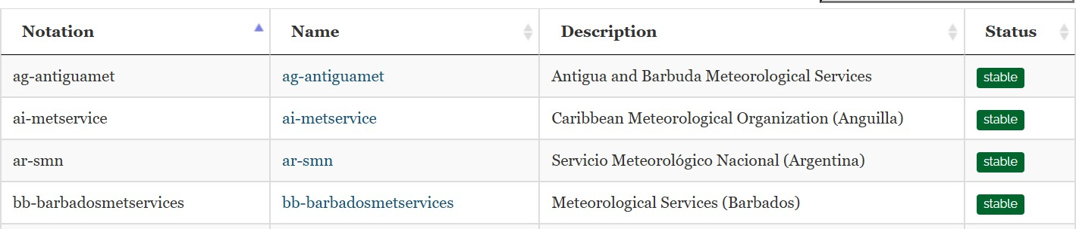
How to setup a WIS2 Node using wis2box
A fresh installation of wis2box will have all required services running to start function as wis2box Before your wis2box can publish anything you must define some datasets :
Using the dataset-editor in the wis2box-webapp, or
Using MCF file (YAML) with CLI in the main container: wis2box dataset publish <mcf-file>
A wis2box-instance becomes a WIS2 Node by completing the WIS2 Node Registration process:
A WMO Member’s “National Focal Point for WIS Matters” can register a WIS2 Node by providing a centre-id and an MQTT-endpoint
One wis2box-instance can host multiple WIS2 Nodes, as the same wis2box-instance can publish data for different centre-ids
Global Brokers subscribe to registered MQTT-endpoints at origin/a/wis2/<centre-id>/# and re-publish all valid MQTT notifications
The centre-id along with a centre description is recorded in the WMO Codes Registry for the WIS2 Topic Hierarchy:
https://codes.wmo.int/wis/topic-hierarchy/_centre-id

Slide 3

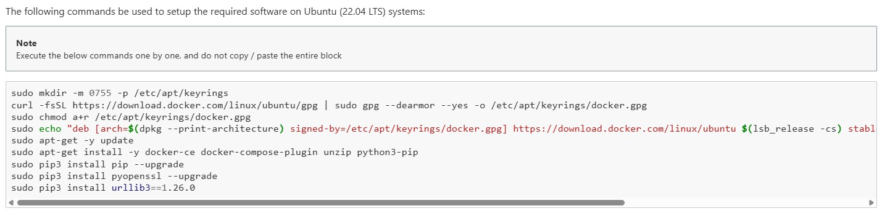
How to setup a WIS2 Node using wis2box
Step 1: Find a host that can be routed to be public internet
Recommended options:
Virtual Machine in your local data-centre (same place as other web services)
Virtual Machine provided by a 3rd party (a.k.a. “Cloud”)
Step 2: Setup your host according to wis2box requirements: https://docs.wis2box.wis.wmo.int/en/latest/user/getting-started.html
Step 3: Install and setup wis2box on your host:
https://docs.wis2box.wis.wmo.int/en/latest/user/setup.html

Slide 4
How to setup a WIS2 Node using wis2box
A fresh installation of wis2box will have all required services running to start function as wis2box Before your wis2box can publish anything you must define some datasets :
Using the dataset-editor in the wis2box-webapp, or
Using MCF file (YAML) with CLI in the main container: wis2box dataset publish <mcf-file>
A wis2box-instance becomes a WIS2 Node by completing the WIS2 Node Registration process:
A WMO Member’s “National Focal Point for WIS Matters” can register a WIS2 Node by providing a centre-id and an MQTT-endpoint
One wis2box-instance can host multiple WIS2 Nodes, as the same wis2box-instance can publish data for different centre-ids
Global Brokers subscribe to registered MQTT-endpoints at origin/a/wis2/<centre-id>/# and re-publish all valid MQTT notifications
The centre-id along with a centre description is recorded in the WMO Codes Registry for the WIS2 Topic Hierarchy:
https://codes.wmo.int/wis/topic-hierarchy/_centre-id
9

Slide 5
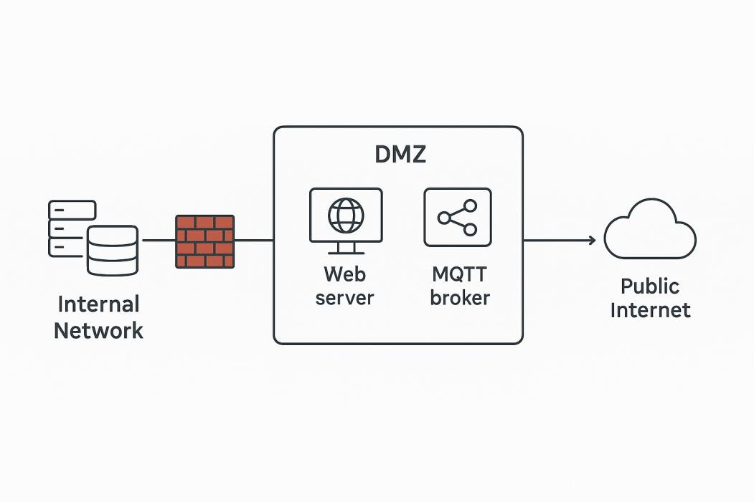


Network isolation
A WIS2 Node is ideally hosted in a DMZ (DeMilitarized Zone) to isolate the WIS2 external-facing services from the internal network
WIS2 Node
10

Slide 6
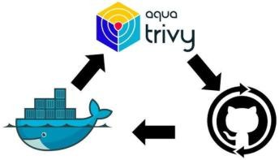


Keeping up to date
The wis2box team reviews and address issues and prepares new wis2box-releases (3-4 times a year)
Daily vulnerability scans automatically run against all wis2box-code repository alerting the wis2box-team to possible security concerns and address them
To report an issue with wis2box please use the wis2box issue tracker on GitHub: https://github.com/World-Meteorological-Organization/wis2box/issues
Subscribe to the wis2box-newsletter to be informed when a new wis2box-release is available: WIS2 in a box Newsletter on the WMO Knowledge Hub
For updates related to WIS2 Operations subscribe to:
WIS2 Operational Newsletter on the WMO Knowledge Hub
11

Slide 7

How to configure datasets in wis2box
Two ways to configure a new dataset in the wis2box:
Use the dataset-editor in the wis2box-webapp
… or share an MCF file with the wis2box-management container and execute ‘wis2box dataset publish <file-path>’
new WCMP2 notification on origin/a/wis2/<centre-id>/metadata for every new dataset published
update WCMP2 notification on origin/a/wis2/<centre-id>/metadata for every updated dataset published
delete WCMP2 notification on origin/a/wis2/<centre-id>/metadata
whenever a dataset is unpublished
WCMP2
new/update/delete
JSON
Global Discovery Catalogue
13

Slide 8
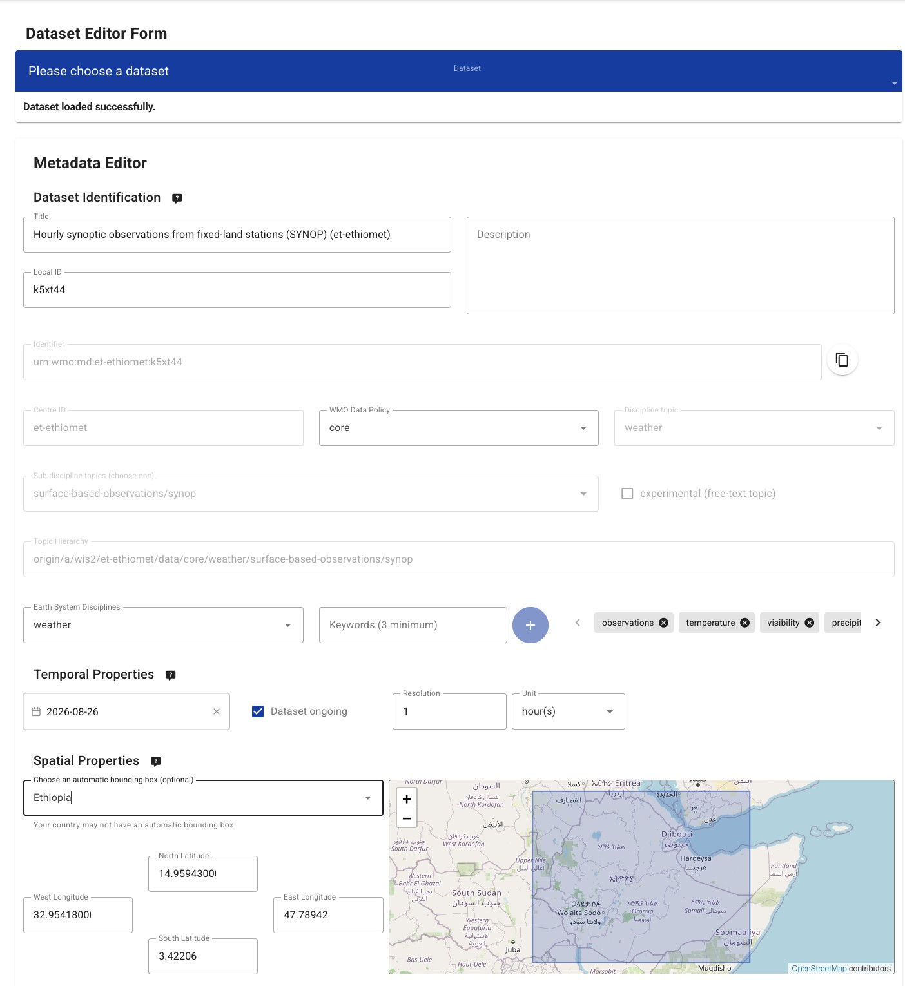
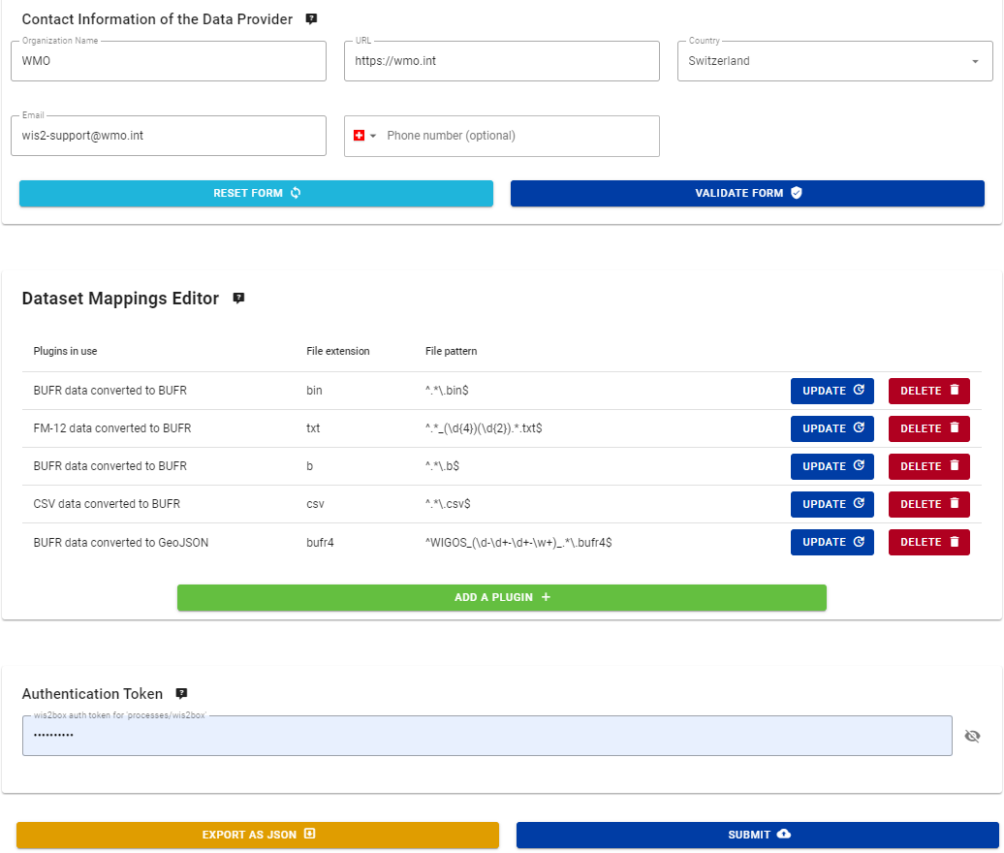
How to configure datasets in wis2box: using the dataset editor
Step 1. Define metadata and validate form Step 2. Define data plugins
Step 3. Provide Authentication Token (created by wis2box-admin)
Step 4. Submit the dataset for publication
14

Slide 9

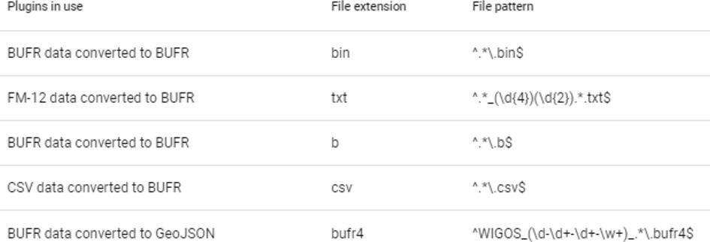
Datasets in wis2box: data plugins
Data Mappings map a specific dataset to a set of data plugins
Data plugins use an abstract model/approach to enable extensibility and reuse
A data plugin defines the actions taken to transform and publish the data See github.com/wmo-im/wis2box/tree/main/wis2box-
management/wis2box/data
NOTE:
Preconfigured data-plugins in data mappings for template=“weather/surface-based-observations” in dataset-editor, can be adjusted as required
or
15

Slide 10
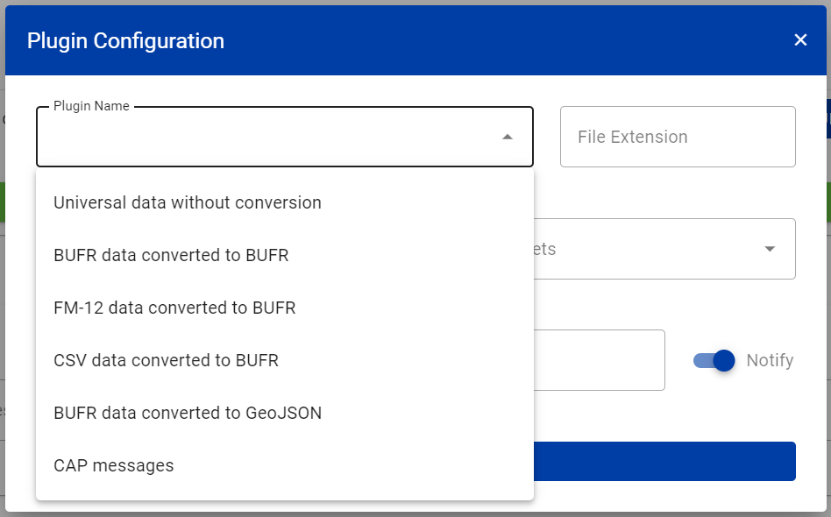
wis2box data plugins
wis2box contains the following built-in data plugins:
wis2box.data.universal.UniversalData
wis2box.data.cap_message.CAPMessageData
wis2box.data.bufr4.ObservationDataBUFR
wis2box.data.synop2bufr.ObservationDataSYNOP2BUFR
wis2box.data.csv2bufr.ObservationDataCSV2BUFR
wis2box.data.bufr2geojson.ObservationDataBUFR2GeoJSON
Developers are encouraged to contribute new data plugins to wis2box!
16

Slide 11

Create Discovery Metadata
Using one of:
- Your favorite text editor!
- Your own wis2box-webapp
- WIS2 Metadata Editor (your installed wis2box )
-

Slide 12




Station metadata in the wis2box
wis2box-management
transform input data create WIS2 notifications create WCMP2 records
retrieve station metadata
Bulk publish stations from CSV
web-interfaces
monitoring map-display timeseries dataset-editor FM-12 input form station-editor
API-backend
wis2box-api
Import station metadata
OSCAR/Surface
“stations” collection in wis2box-api can be populated in multiple ways:
Provide station list as CSV and use command line inside wis2box-management container
Interactively using the station editor inside the wis2box-webapp
18

Slide 13
Station metadata used in transformation to BUFR
FM-12 to BUFR (synop2bufr):
Add the WIGOS-station-ID, derived by matching with traditional station identifier in FM-12 input
Add the latitude, longitude, altitude and barometer height above sea-level in the BUFR content
CSV to BUFR (csv2bufr):
Check WIGOS-station-ID in input data is in station-list for associated topic
For fixed land stations: check input-data-location is less than 1km from station metadata location
BUFR to BUFR (bufr2bufr):
Splits by bulletin and check WIGOS-station-ID in station-list for associated topic
If WIGOS-station-ID missing add it (by matching with traditional station identifier)
if the location or station elevation are missing in the input BUFR use values from station metadata
19

Slide 14
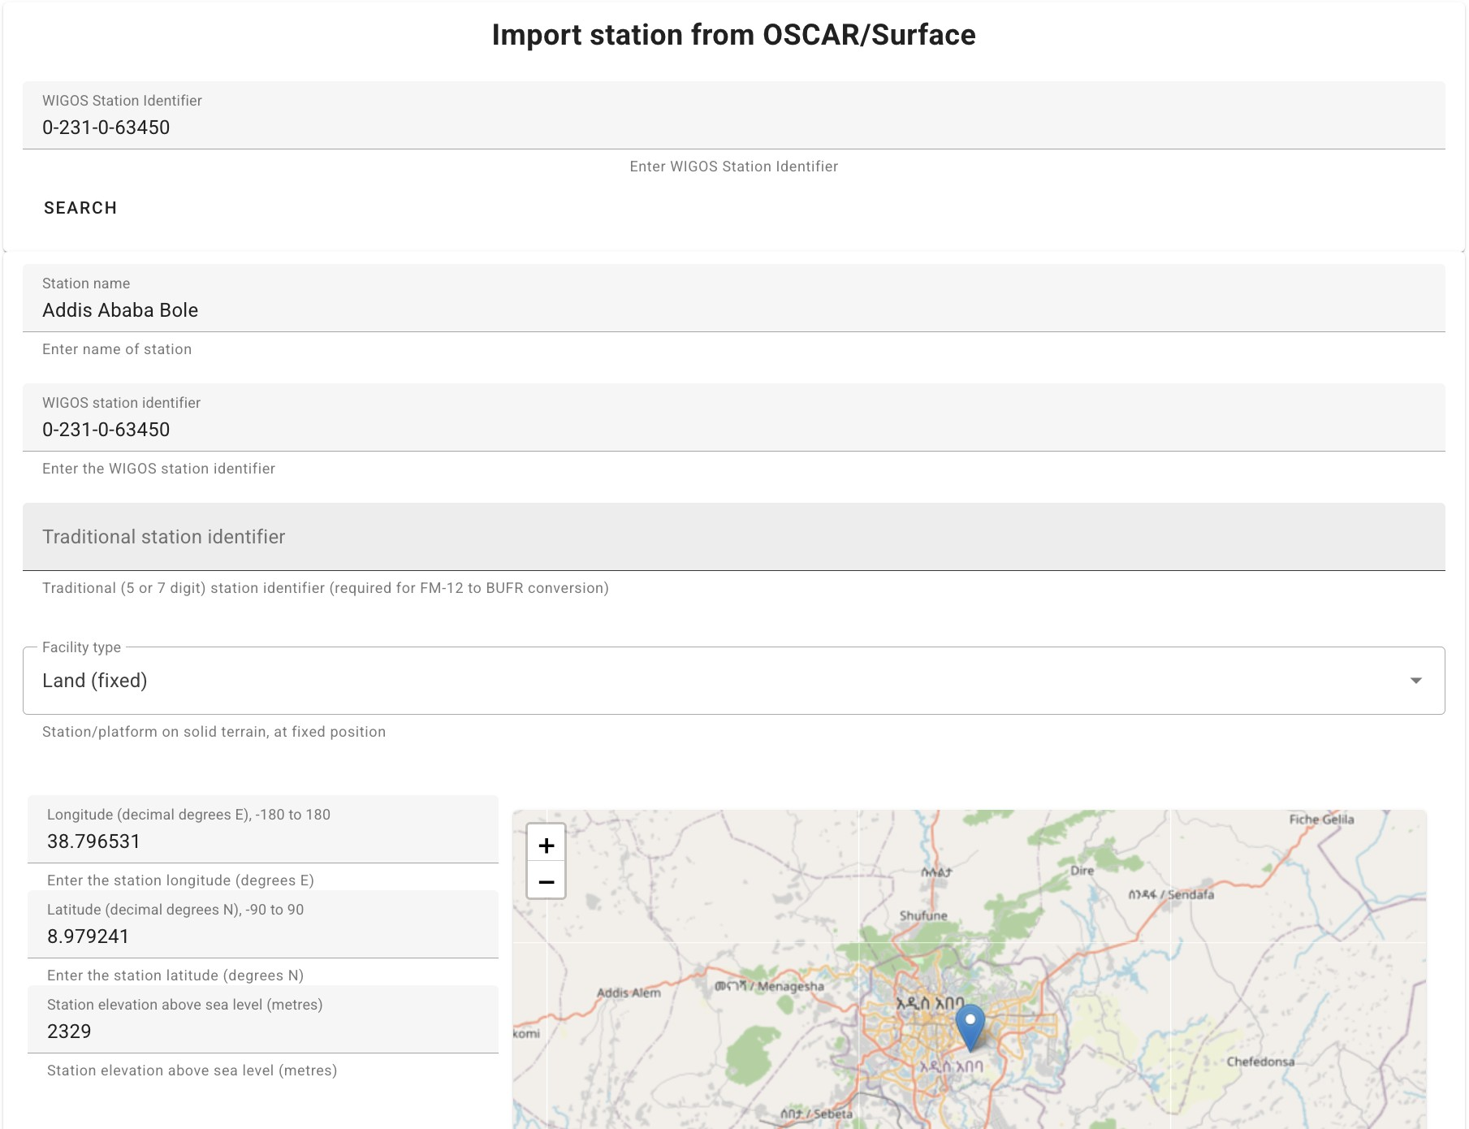
How to configure stations in wis2box-webapp
You can update the wis2box station-list using the station editor in the wis2box webapp, importing data from OSCAR
<wis2box-host-url>/wis2box-webapp/station
20

Slide 15
Create Stations
Using one of:
- Your own wis2box-webapp
-

Slide 16

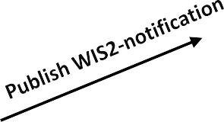
Summary
To publish data using wis2box you must first define a dataset and publish WCMP2
In wis2box, datasets are used to define both the discovery metadata and the data plugins Data plugins determine the actions taken to transform and publish the data
wis2box includes pre-defined data plugins to enable users to transform data to BUFR using ecCodes
The dataset-editor makes it easier for users to define the correct data-plugin for their data-type by providing “templates” that can be selected when creating a dataset
wis2box-management container listens to events from MinIO to trigger data processing The file-path of the incoming data is used to determine the corresponding dataset
National Sector
storage
data uploaded
incoming
public
wis2box-management
apply data-mappings create WIS2-notifications create WCMP2-records
22

Slide 17
Thank You

